Slide 1
iMDb Movie Scraping and Regression Analysis
Delivered by
IBRAHIM ALHAMMAD
WAAD ALDUHAMI

Slide 2
TABLE OF CONTENTS
01
INTRODUCTION
02
PROPLEM
03
ANALYZING
04
CONCLUSION

Slide 3

INTRODUCTION
The Internet Movie Database (IMDB) is an online database of information related movies, TV shows, celebrities, genre, reviews, etc. The IMDB website enables registered users to rate different movies,TV shows and actors on scale of 1 to 10.

Slide 4




PROPLEM
As we all now that there are a lot of Production Companies in the World like (Universal Pictures, Warner Bros., Columbia Pictures and Walt Disney Pictures)
so in our project we will talk about how to help them to get a higher rating based on iMDb top 250 movies scarped data from iMDb website
01
02
03
04

Slide 5
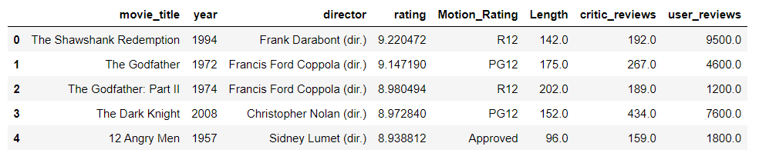
ANALYZING
In our analysis we used the top 250 movies rated based on iMDb website and this is the top 5 with the columns we use

Slide 6
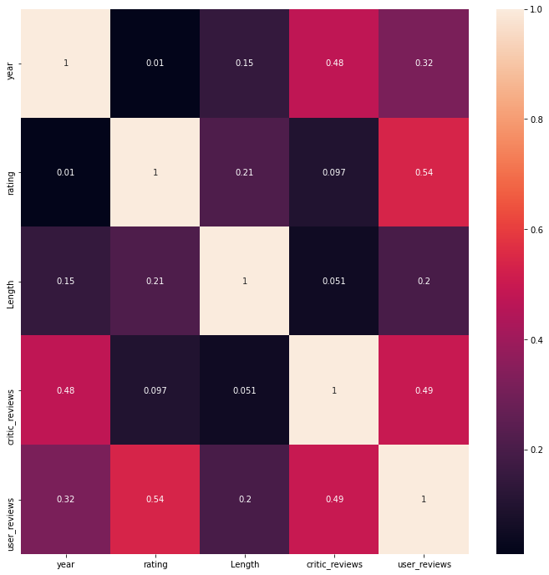
ANALYZING

Slide 7
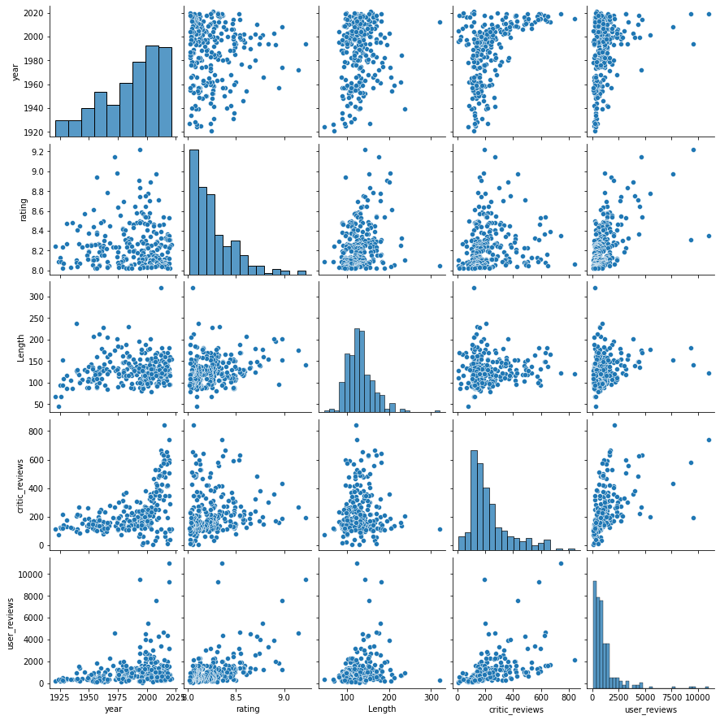
ANALYZING

Slide 8
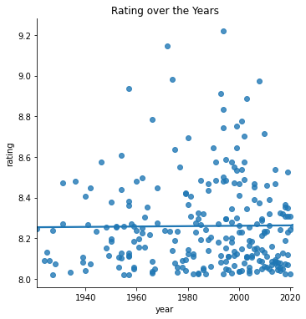
ANALYZING

Slide 9
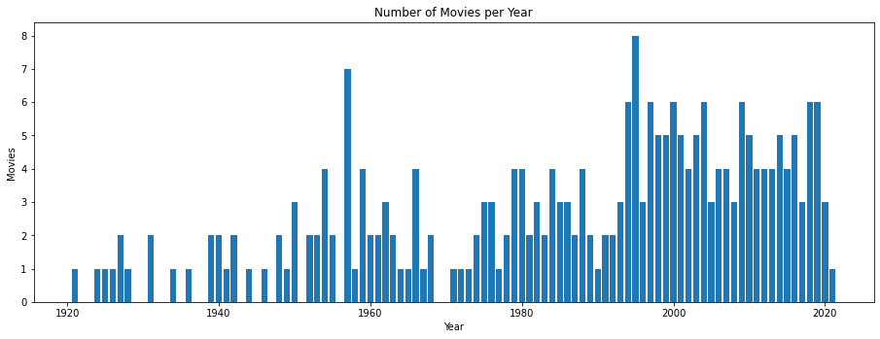
ANALYZING

Slide 10
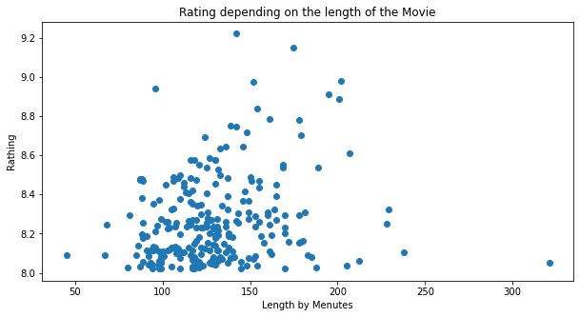
ANALYZING

Slide 11
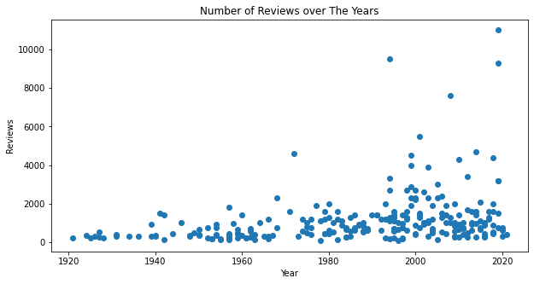
ANALYZING

Slide 12
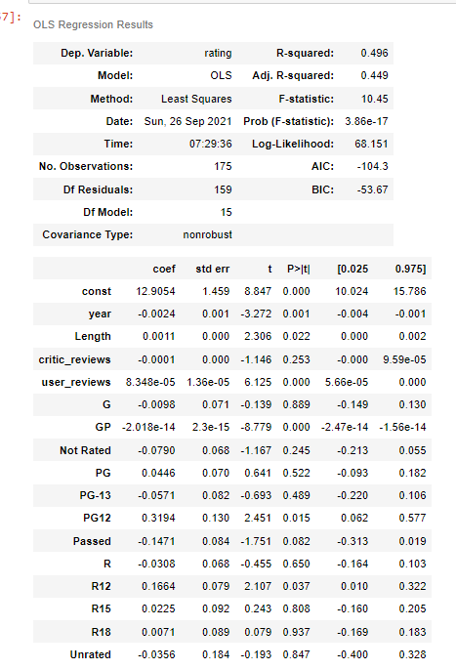
ANALYZING

Slide 13
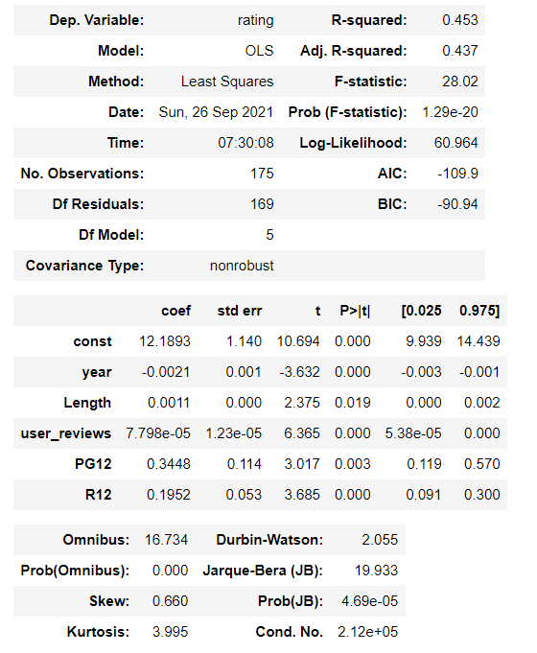
ANALYZING

Slide 14
CONCLUSION
In conclusion we can say that the movies probably have a higher rating when they are in the average of 90m to 150m and the critic reviews are important along with the user reviews

Slide 15
THANKS!

